Slide 1
Disability Awareness Training
By: Getahun Solomon Sosango
(Lecturer of Special Needs and Inclusive Education at HU)
January, 2021
Hawassa, Ethiopia

Slide 2
Objectives
At the end of this course, you will be able to:
Prepare yourself to welcome people with disabilities into your workplace
Interact with people with disabilities
Identify and overcome barriers in the workplace
Use respectful, appropriate, acceptable language in any circumstance
Understand what job accommodation is and how it applies in your workplace
Differentiate between impairment and disability, and briefly summarize the different ‘models’ of disability.
Describe key aspects of appropriate communication with people with disabilities.
Describe the prevalence of disability and the major causes of disability.
Explain how you can support community rehabilitation in your catchment area.

Slide 3
1.1. Definitions of basic Terms and concepts
Impairment is any loss or abnormality of psychological, physiological, or anatomical structure or function.
(e.g., a missing limb)
Impairments are problems in body function or structure as a significant deviation or loss.
  Body functions are the physiological functions of body systems (including psychological functions)
Impairments represent a deviation from certain generally accepted population standards.

Slide 4
The presence of impairments do not necessarily indicate that a disease is present or that the individual should be regarded as sick.
Impairments can be temporary or permanent; progressive, regressive or static; intermittent or continuous.
Disability is any restriction or lack (resulting from an impairment) of ability to perform an activity in the manner or within the range considered normal for a human being.

Slide 5
Disability is a condition caused by an accident, trauma, genetics or disease that may limit a person’s mobility, hearing, vision, speech or cognitive function.
It is incapacity recognized by law as limiting or preventing, for example, mobility.
A disability exists when an impairment limits a person’s ability to perform certain tasks (e.g., walk, see, etc)
It can be also be defined as a functional limitation

Slide 6
Historical Background
History tells us that prior to the late 1700s, the fate of disabled individuals was likely to be a cruel one and the Greeks and other early cultures were often cited by their practice of killing unwanted children. In most religions and cultures disability was regarded as;
a punishment,
consequences of ancestral anger, or
- retribution by divine force and disabled people were regarded as unfortunate, different and blemished. Moreover, this concept of disability as a divine punishment was often associated with negative attitudes and beliefs that raise shameful feelings for people with disabilities and their families.

Slide 7
There were different stages and periods on the life of people with disabilities and their families. These were:
The elimination period
During this time people with certain types off physical disabilities were subjected to getting rid off from the societies.
Poor house period
It was relatively better than the first period in which individuals with disabilities were removed from the views of non disabled individuals.
Institution care period
This was the time when people with disabilities were provided services on segregated base.
Integration
This period encourages a process that would lead to the integration of people with disabilities, their families and their communities.
Self actualization and empowerment
This is the highest level on the life of people with disabilities and their families, focusing and creating the condition that enable to develop their fullest potential.

Slide 8
Q. What are causes for Disability?
______________________________
____________________________________________________________________________________________________________________________
Which time is more sensitive?
Pre-natal
Per- natal or Post- natal?

Slide 9
Major causes of impairment
Genetic Causes
Disease
Poverty
Wars
Drought
Famine
Harmful traditional practices
Household, work place and traffic accidents.
Sanitation problem
Lack of balanced diet
Unknown causes …

Slide 10
Models of Disability
A ‘model’ means a particular way of understanding or describing a complex social phenomenon such as disability.
These are frameworks which help to explain the ways in which society responds to disability and to review the appropriateness of its responses.

Slide 11
The religious, or charitable, model of disability
view people with disabilities as victims of impairment and as the beneficiaries of charity, alms, and services – for which they should be grateful.
People with disabilities are viewed as tragic or suffering people, to be pitied and cared for.
People with disabilities may find that they have few choices, no means of accessing relevant advice, and no powers to decide how they could best be assisted.
Services are designed for them and delivered to them, perhaps with the best of intentions, but with insufficient consultation.

Slide 12
It is not uncommon for people with disabilities to become dependent upon the source of help, and for the alms-givers to gain gratification and reward from the relationship. Charity is provided at the discretion of the giver, often on the basis of ‘worthiness’. If the person providing charity or care decides that the disabled person is unworthy, bitter, or ‘negative’, help may be withdrawn on a whim. People with disabilities are often caricatured as being tragic and passive, if they need high levels of support; as bitter, twisted, and aggressive, if they are beginning to question the status quo; and as courageous and inspirational if they have managed, against all the odds, to overcome the barriers that confront them.

Slide 13
Extra resources are necessary in order to provide such special services, and in resource-poor economies the inability to provide adequate levels of service (in health care, education, production) for the whole population is frequently used as a justification for doing very little to provide special services for disabled people

Slide 14
Summary of charity model
The charity model of disability is a traditional way of viewing persons with disabilities as being dependent and helpless. In this model, people with disabilities are seen as:
Objects of charity
Having nothing to give, only to receive
Being inherently poor, needy and fully dependent on charity or welfare for their survival.

Slide 15
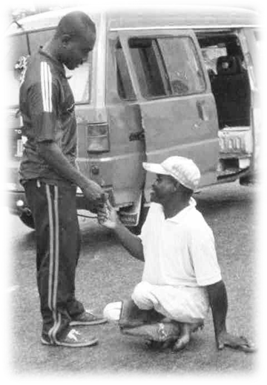
« Handicapped people are poor and helpless. Somebody needs to spare a penny and help them. They are a real burden to society.»
How do communities generally respond?
Notes:
Question: how would you characterize the model of disability conveyed by this statement?
Charity model
This statement reflects the « charity model of disability ».
Perception: disabled people are objects of charity with need of protection.
The « disabled » are a burden to society. They live mainly on charity and have a lower social status. They have to be « protected »
Many workers respond through acts of charity and basic medical care.
The low social position and existing prejudices are rarely challenged.
Examples :
disabled people are often beggars, their suffering makes them « pure »
disabled people are fed and clothed in charity hospitals or shelters
Hospitals, clinics or shelters run by faith-based groups
Community response:
Cash handouts to persons with disabilities who are poor. This might provide enough to buy food for a limited period of time, but it does not supply people with a sustainable income.
Isolating people with disabilities to protect them
SG

Slide 16
The problem with such practices is that they reinforce the idea that people with disabilities are helpless recipients of ‘charity’ from a ‘caring’ society, rather than subjects with rights.

Slide 17
Question
Can you think of people in your community who see disability in terms of the charity model? How would you try to change their views?

Slide 18
The medical model of disability
The medical model tends to view people with disabilities first and foremost as having physical problems to be cured. The disabled person is relegated to the passive role of patient, with medical personnel and care professionals making many decisions – even about issues unrelated to impairment, such as how the individual should dress or what he or she may eat. This model is problematic because of its excessive focus on the desirability of fixing the disabled person’s impairment.

Slide 19
Corrective surgery is used to extend and straighten limbs, callipers are applied, and people are encouraged to try to walk, rather than use wheeled mobility appliances; deaf people are taught to speak and lip-read.

Slide 20
What ‘disabilities’ are there?
A disability prevents some people from doing the things
most other people can do
Some examples of disability:
1 in 8 people
are disabled
Visible
  Mobility difficulty
  Autism
  Cerebral palsy
  Stroke
  Asthma
  Multiple sclerosis
Invisible
  Cancer
  Hearing impairment
  Dyslexia
  Depression
  Epilepsy
  Pacemakers
Notes:
It is worth considering just how common disability is and what a range of disabilities exist within our communities. Show the slide title and ask the group to consider all the ‘disabilities’ they are aware of.
Show the examples listed, explaining that it is not, in any way, an exhaustive list. Highlight how some are very visible – like mobility difficulty - and some are much less visible – like depression – but they can all affect the ability of some people to do the things most other people can do and, perhaps, take for granted.
The Disability Discrimination Act (DDA) defines a disabled person as ‘someone who has a physical or mental impairment that has a substantial and long-term adverse effect on his or her ability to carry out normal day-to-day activities’.
When the whole broad scope of disability is considered, 1 in 8 people are disabled in some way. This makes disabled people a very significant ‘minority’ group in our society.

Slide 21
There are three models for thinking about disability and disabled people - ‘traditional, medical’ and ‘social’
The person is
the problem
The traditional medical model, historically originated by the medical profession, says that
  Disability is a medical problem that needs to be overcome
  The body is faulty and needs repair
  Disabled people should be segregated from ‘normal’ society and put in special schools and day centres
Notes:
The traditional medical model sees the person as the problem. By referring to it as the ‘traditional’ medical model, it should be made clear that this does not suggest all medical and healthcare professionals today will hold this view – simply that it is a view about disability that has been, historically, dominant and, despite greater awareness and sensitivity to the needs of disabled people in more recent times, it still influences the views and actions of many people in our society.
It sees the disabled person as ‘faulty’ and in need of repair to make them ‘whole’ or ‘better’. The aim is to reduce or cure the fault – the disability must be overcome to help the person function in ‘normal’ society. This model suggests that, since the needs of disabled people are so different and specialised, they are best met through segregated provision of support.
The language that this model engenders can be provocative and this slide is likely to prompt discussion and, perhaps, disagreement from learners. It is uncomfortable to think about disabled people being considered in this way. The model, as described here, is a very simple overview to highlight the difference between the two models. There is a large body or literature and debate about this and the social model, which learners can be encouraged to seek out and explore if this promotes their interest.

Slide 22
Medical model
The medical model sees the disabled person as the problem that needs to be fixed or changed
Can’t communicate
Is disruptive
Confined to wheelchair
ISSUE
An individual with one or
more conditions
or impairments who
has the ‘problem’
Needs help to do things
Can’t walk
Requires medication
Depends on a hearing aid
Can’t understand

Slide 23
The medical model perceives disability as a problem located in the disabled individual, and assumes that working on the individual can solve it (or not, as the case may be, in which case the person concerned might as well give up all hope of a full and satisfying life).

Slide 24
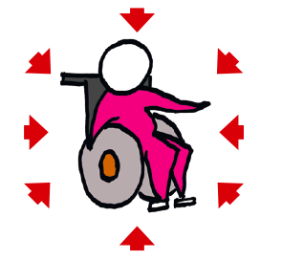

Slide 25
The Social Model of Disability
The social model identifies three major barriers that confront disable people who have impairments: physical (exclusion from the built environment), institutional (systematic exclusion or neglect in social, legal, educational, religious, and political institutions), and attitudinal (negative valuations of people with disabilities by non-disabled people).

Slide 26
Removing these barriers is possible and has a hugely beneficial impact, both on the lives of people with disabilities and on the whole community.

Slide 27
The social model of disability
Inaccessible transport
lack of support
Poorly designed buildings
ISSUE
Disabling environment
Negative attitudes
Barriers
Discrimination
Poverty
Lack of understanding from others
Lack of accessible information
Too few Sign Language Interpreters
Negative perceptions

Slide 28
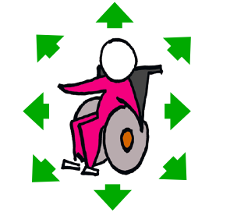

Slide 29
Medical model vs. Social model
Medical model | Social model
The individual is the problem. | The barriers are problems created society.
The individual needs to change. | The barriers need to be removed.
Disabled people become the victim, client, have no responsibilities an are disempowered. | Disabled people have independence, control and choice.
Information on impairments is used to categorise people. | Information on access needs is on a need to know basis to ensure inclusion.

Slide 30
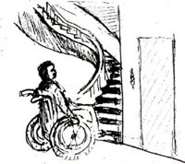
Figure: An example of an environmental barrier.

Slide 31
So… which model will you use?
I hope this has given you an insight into the difference between the traditional medical and social models of disability
Adopting the social model, quite literally, makes the world of difference

Slide 32
Part II: About Stereotypes
One of the biggest barriers to diversity is our tendency to stereotype.
Stereotypes can be so subtle that we don’t even realize we’re applying them.

Slide 33
For instance, how do you feel when the following words are mentioned to you?
Ethiopian: ___________
Women: _____________
Athletes: _____________
Nurse: _______________
Scientists: ____________
Teacher: ____________

Slide 34
We make the same kind of stereotypes when it comes to people with disabilities. Can you think of some examples?
___________________________________
___________________________________
___________________________________
___________________________________

Slide 35
Some Common Phrases and the Stereotypes behind PWDs
There are many phrases that connote stereotypes and are derogatory.
One that I often hear, although it is becoming less popular as people become more aware, is “That was a stupid thing to do. You must be retarded or something!” This reveals two stereotypes: that if someone makes a mistake, they are stupid; and that being stupid, they must have some form of mental disability (which used to be referred to as “retardation”).

Slide 36
Why do we find it so natural to make quick judgments about some people, even when we know that we don't have enough information about them?
__________________________________
Can you recall any situations in which the potential contribution of someone was limited because they had been stereotyped?
________________________________________

Slide 37
Session Three: Misconceptions and Realities
There are plenty of misconceptions, as well as realities, to working with people with disabilities. We’ll explore some of those here.

Slide 38
Employees with disabilities will cost my sick leave and extended health benefit plans money
People with disabilities are less likely to have accidents than other employees.
It is expensive to accommodate workers with disabilities.
Certain jobs are better suited to disabled people.
Employees with disabilities are not able to meet performance standards.
People with disabilities will have problems with transportation.
Disabled workers are a good influence within the workplace.

Slide 39
General Guidelines

Slide 40
It’s also not productive if you are constantly worrying about what you say. Instead, let’s go over a few ground rules that will ensure your speaking correct.

Slide 41
- Being Practical
- Apologize if you goof up.
- Don’t make fun.
- Ask what a person prefers.
- Develop relationships.
- Mingle with Me
- People with disabilities are people, not the equipment that serves them.
- Ask, instead of always offering help.

Slide 42
- Be clear in your communication, including your instructions.
- Treat service animals with respect.
- Aim to please.

Slide 43
Appropriate and Acceptable Language
There is often much confusion around the language to be used when talking about disability and/or addressing persons with disabilities.

Slide 44
Appropriate and inappropriate terms
In your daily work it is important to keep the following guidelines in mind:
When describing a person, focus on their abilities and actions rather than their limitations, and avoids words that imply that they are passive ‘objects’ rather than active subjects.
Expressions like ‘she uses a wheelchair’ or ‘he is partially sighted’ are preferred to terms such as ‘confined to a wheelchair’ or ‘partially blind’.

Slide 45
Avoid ‘sensationalising’ an impairment by using expressions such as ‘afflicted with’, ‘victim of’, ‘suffering from’, and so on.
Emphasise the individual, rather than the impairment, by saying, for example, ‘a person with paraplegia’, instead of ‘a paraplegic’ or ‘a paraplegic person’. For the same reason, avoid grouping individuals into generic categories through expressions like the deaf, the blind, etc.

Slide 46
When talking about places or buildings designed to overcome the barriers faced by people with disabilities, use the term ‘accessible’ (e.g. ‘an accessible parking space’) rather than ‘parking for the disabled’ or ‘for the handicapped’.
Finally, people without disabilities should not be referred to as ‘normal’, ‘healthy’ or ‘able-bodied’. People with disabilities are not – as such expressions suggest – ‘abnormal’, ‘sick’ or ‘unable’.

Slide 47
It is appropriate for you to continue using words such as ‘see’, ‘look’, ‘walk’, ‘listen’, when talking to people with various disabilities, even if the person is, for example, partially sighted or uses a wheelchair or hearing aid.

Slide 48

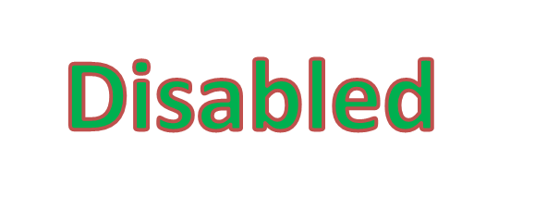
Terminology and Etiquette

Slide 49

No- No’s
Handicapped
Victim
Crippled
Wheelchair- bound
Mentally Retarded
Crazy, Manic, Lunatic, Schizo, Psycho
Epileptic, spaz
Midget
Deaf and Dumb
The Disabled

Slide 50
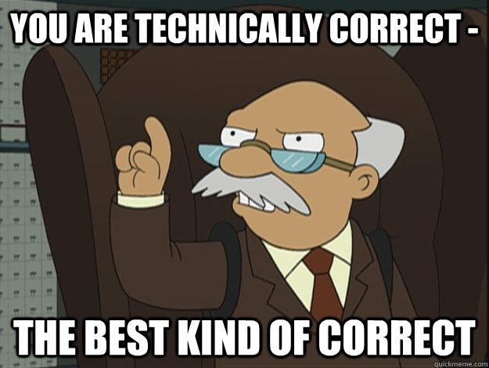
DO’s
James has diabetes
  Not: He’s a diabetic
Vicky has a disability
  Not: She is handicapped
Al has depression
  Not: He suffers from depression
Jessica has PTSD
  Not: She is a victim of PTSD

Slide 51
Instead Of… | Try…
Handicapped | People with disabilities; people with special needs
Retarded | Developmentally challenged
Gifted children | Advanced learners
Uneducated | Lacking a formal education
Old people | Seniors; the elderly
Birth defects | Disabled since birth
Deaf and dumb | Deaf person who is unable to speak
Wheelchair bound | Person who uses a wheelchair
Crippled with | Person who has (name the illness or disease)

Slide 52
Session Six: Accessibility
Physical Access
Parking
Ramps
Restrooms
Doorways
Barriers

Slide 53
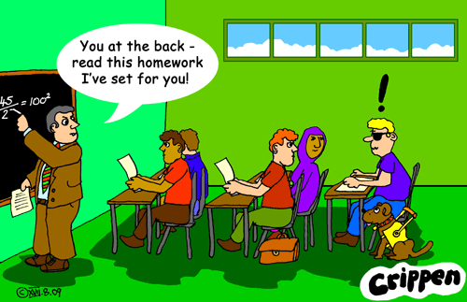
Reasonable Accommodations
A modification or adjustment to a job or the work environment that will enable a qualified applicant or employee with a disability to participate in the application process or to perform the essential job functions
Examples:
Providing physical access
Restructuring a job
Modifying a work schedule
Providing a reader
Providing an interpreter
Providing assistive equipment
  Magnified screen for People with low vision
  Dragon Dictate for people with learning disorders

Slide 54
Case Studies
Generate a list of places in your own workplaces and/or your communities where they see poor accessibility and barriers. With each example, provide a solution of how to eliminate or reduce the barriers.

Slide 55
Example
Accessibility Issue
___________________________________
___________________________________
___________________________________
___________________________________
Possible Solutions
_____________________________________________________________________________________________________________________________________________________________________________________

Slide 56
Guidelines for talking with a person with an intellectual disability
Speak slowly and leave pauses for the person to process your words.
Speak directly to the person, and ensure they feel central to the consultation.
Speak in clear short sentences. Don’t use long, complex, or technical words and jargon.
Ask one question at a time, provide adequate time for the person to formulate and give their reply.
If necessary obtain information from parents/caregivers, maintain the focus on the person with the disability through your eye contact, body language and/or touch.

Slide 57
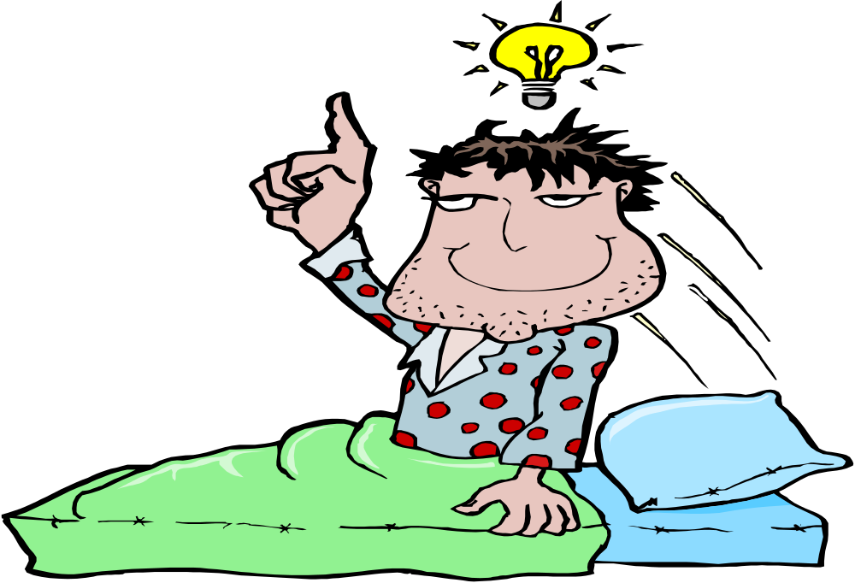
Do you have a question and comment?

Slide 58
Thank you

